Slide 1
Fraud Detection in Credit Card Transactions using ML Technique
System Software Engineering
Name:- MD Faizan
B.tech CSE 6th Sem
Sid. :- 73735
Enrolment No. PROCP10201913631

Slide 2
Overview :-
What is Fraud Detection?
Credit Card Transaction.
Fraud in Credit card Transaction.
Why it is important to Fraud Detection in Credit Card Transaction?
From my thought of view.

Slide 3
What is Fraud Detection?
Fraud detection is defined as a process that detects scams and prevents fraudsters from obtaining money or property through false means. Fraud is a serious business risk that needs to be identified and mitigated in time. This article explains fraud detection in detail and shares some best practices that should be followed in 2021.
Fraud detection is a process that detects and prevents fraudsters from obtaining money or property through false means. It is a set of activities undertaken to detect and block the attempt of fraudsters from obtaining money or property fraudulently. Fraud detection is prevalent across banking, insurance, medical, government, and public sectors, as well as in law enforcement agencies.

Slide 4
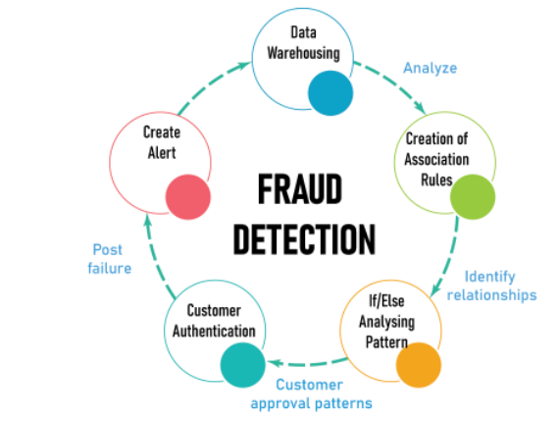

Slide 5
Fraudulent activities include money laundering, cyber-attacks , fraudulent banking claims, forged bank checks, identity theft, and many such illegal practices. As a result, organizations implement modern fraud detection and prevention technologies and risk management strategies to combat growing fraudulent transactions across diverse platforms.
These techniques apply adaptive and predictive analytics (i.e., machine learning) to create a fraud risk score along with real-time monitoring of fraudulent events. This allows continuous monitoring of transactions and crimes in real-time. It also helps decipher new and sophisticated preventive measures via automation.

Slide 6
Fraud detection is of paramount importance for banks and other companies that deal with a significant number of financial transactions and are therefore at higher risk of suffering from financial fraud. However, other sectors such as ecommerce companies, credit card companies, electronic payment platforms, and B2C fintech companies also need to employ fraud detection to prevent or limit financial fraud.
The most common applications of fraud detection include account-related-fraud and payment and transaction fraud. Account fraud is further divided into new account fraud and account takeover fraud. In new account fraud, new accounts are created by using fake identities. Such frauds can be identified by using the patterns of various devices and session indicators for detecting fake identities.
Account theft frauds occur when a hacker obtains products and services by using another person’s existing account. In order to prevent this, session, device, and behavioral biometrics of the user can be computed and scored to verify an account. In addition, analyzing user journeys for behavioral patterns can help detect account takeovers before they cause any financial harm.
Payment fraud is any kind of false or illegal transaction that is carried out by a cybercriminal. The perpetrator cheats the victim of money, personal property, interest, or sensitive information. This category further includes unauthorized transactions fraud, stolen merchandise fraud, and false requests for refund fraud.

Slide 7
Credit Card Transaction.
A lot of things happen between the time you swipe your credit-card and sign the credit card slip. Everything that happens behind the scenes makes it possible for you to make purchases with your credit card instead of having to go to the bank every time you want to spend money from your credit limit.
A few people/entities are involved in each credit card transaction:
The customer (you) presents the credit card for payment.
The merchant sells you goods or services.
The merchant's bank sends credit card transactions for approval.
The credit card payment network is a liaison between the merchant bank and the credit card issuer.
The credit card issuer approves and pays transactions.

Slide 8
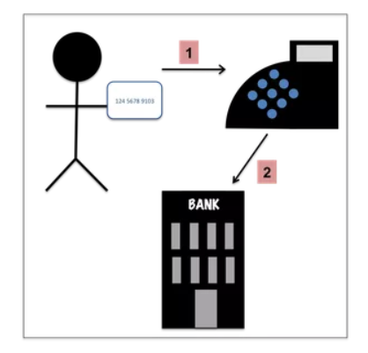
Swipe Your Credit Card for Approval
You present your card for payment by inserting it into an EMV card reader, tapping it on the terminal for a contactless transaction, or swiping the magnetic stripe. The payment terminal communicates with the merchant bank to ask whether you can make the credit card purchase.
Most credit cards now come with microchip technology. These so-called “smart-cards”," or "EMV cards" (Euro-pay, Mastercard, and Visa) embed a microchip on the front of the card that contains information pertaining to the account associated with the card, similar to what is contained in the magnetic stripe on the back of the card. Rather than swiping your card, it is inserted into the card reader. Introduced in the United States in 2015, smart cards are considered more secure and less vulnerable to fraud.

Slide 9
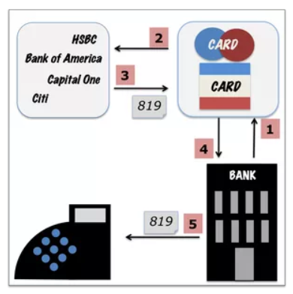
Credit Card Authorization
The merchant bank contacts the appropriate credit card network (Visa, Mastercard, American Express, or Discover) to get authorization for the credit card purchase. Then, the payment network contacts the credit card issuer to make sure the credit card is valid and there's enough available credit for the transaction.
American Express and Discover are the payment network and the credit card issuer, so they approve credit card transactions themselves. Visa and Mastercard, however, do not issue credit cards and must contact the credit card issuer.
The credit card issuer sends back an authorization response for the transaction. If your credit card is declined, you won't get a reason at the point of sale, just a message that the card was declined. You'll have to contact your card issuer directly to find out why your card was declined.
The store’s bank sends their communications electronically either through the phone line or through the internet. Before the widespread use of Wi-Fi (Wireless Fidelity), you may have been to a store or restaurant and heard the screeching and static from the credit card terminal using a dial-up connection to communicate with the merchant bank. Now you know what all the noise was about.

Slide 10
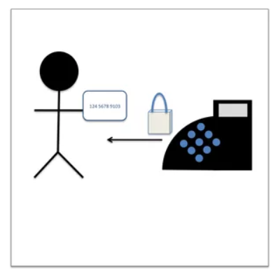
Credit Card Approval
The merchant bank sends the approval message for your credit card purchase, the receipt prints, you sign, and you can leave with your purchase. When you use your card’s EMV chip, the merchant is not required to obtain your signature.
When you leave the store with your purchase, your credit card has only been authorized for the payment. The merchant hasn’t actually been paid and your credit card hasn’t been charged. If you check your credit card online right after you’ve made a purchase, the credit card issuer may show authorized transactions and may have reduced your available credit by the amount of your recent purchase.

Slide 11
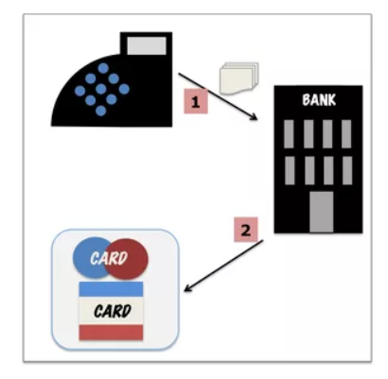
Batch Processing
Typically, at the end of the day, the merchant transmits a batched list of all the credit card transactions that have been made that day and sends them to their bank. Some merchants settle transactions individually in real time as they occur, rather than batching them for daily processing. The merchant’s bank then sends the transactions to the appropriate payment network for processing.

Slide 12
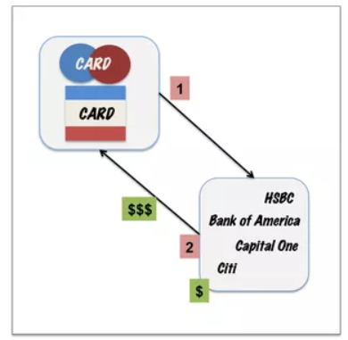
The Credit Card Issuer Sends Payment
The credit card network lets each credit card issuer know what payments are due. The credit card issuer keeps a fee, the interchange fee, as part of its agreement with the merchant, for processing costs and risk. Credit card networks charge an assessment fee to use the network.

Slide 13
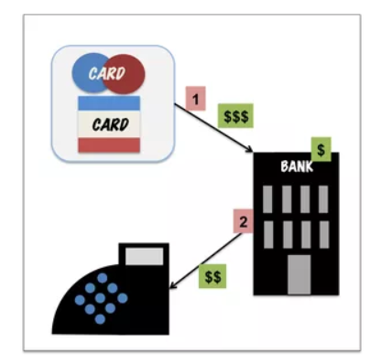
The Merchant Gets Paid
The credit card network sends payment to the merchant bank who collects its own fee before depositing the credit card charges in the merchant's account.

Slide 14
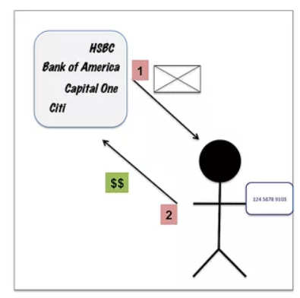
The Credit Card Issuer Bills You
Each month, the credit card issuer sends a bill for the charges you made during the month. Then, you pay some or all the charges. If you choose to pay only a portion of the charges, you'll pay interest on the amount that you don't pay. The credit card issuer uses your balance and interest payments to reimburse merchants as new transactions are made.

Slide 15
Fraud in Credit card Transaction
The challenge is to recognize fraudulent credit card transactions so that the customers of credit card companies are not charged for items that they did not purchase.
Main challenges involved in credit card fraud detection are:
Enormous Data is processed every day and the model build must be fast enough to respond to the scam in time.
Imbalanced Data i.e most of the transactions (99.8%) are not fraudulent which makes it really hard for detecting the fraudulent ones
Data availability as the data is mostly private.
Misclassified Data can be another major issue, as not every fraudulent transaction is caught and reported.
Adaptive techniques used against the model by the scammers.

Slide 16
Fraud in Credit card Transaction
How to tackle these challenges?
The model used must be simple and fast enough to detect the anomaly and classify it as a fraudulent transaction as quickly as possible.
Imbalance can be dealt with by properly using some methods which we will talk about in the next paragraph
For protecting the privacy of the user the dimensionality of the data can be reduced.
A more trustworthy source must be taken which double-check the data, at least for training the model.
We can make the model simple and interpretable so that when the scammer adapts to it with just some tweaks we can have a new model up and running to deploy.

Slide 17
Why it is important to Fraud Detection in Credit Card Transaction?
How to tackle these challenges?
The model used must be simple and fast enough to detect the anomaly and classify it as a fraudulent transaction as quickly as possible.
Imbalance can be dealt with by properly using some methods which we will talk about in the next paragraph
For protecting the privacy of the user the dimensionality of the data can be reduced.
A more trustworthy source must be taken which double-check the data, at least for training the model.
We can make the model simple and interpretable so that when the scammer adapts to it with just some tweaks we can have a new model up and running to deploy.

Slide 18
From My thought of view
From my thought of view fraud detections takes major role in credit card transactions in which we may detect the wrong access from which we consider different unwanted categorial way or persons to identifies these failures which always makes to be considered. It is more beneficial with machine learning. It is an application of Machine Learning in Banking Sector.

Slide 19


